Slide 1
Deep Learning Method of
Drone Detection Using
Acoustic and Visual Features
K2S3
Dongwhan Lee, Juann Kim, Youngseo Kim
Heeyeon Shin, Yeeun Heo

Slide 2
Contents
Team Member
Introduction
Outdoor Experiment Setup
Experiment Process and Result
Conclusion

Slide 3

Deep Learning Method of
Drone Detection using
Acoustic and Visual Features
1. Team Member

Slide 4
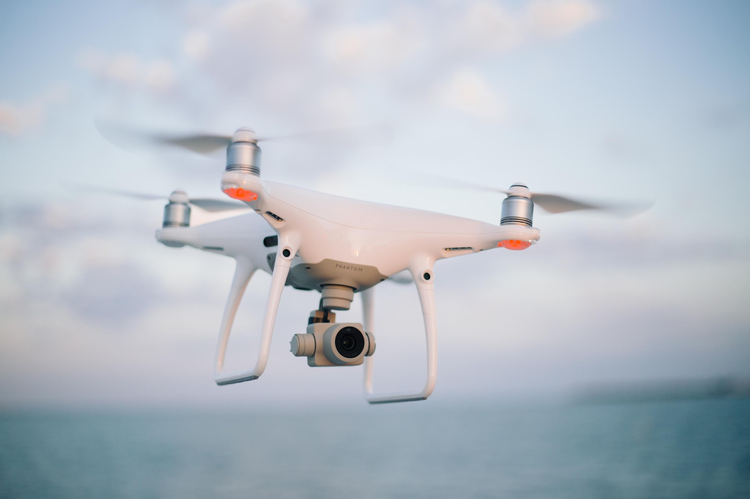





1. Team Member
Leader
Dongwhan
Lee
Youngseo
Kim
Juann
Kim
Heeyeon
Shin
Yeeun
Heo
Kyunghee Univ.
Sangmyung Univ.
Sangmyung Univ.
Kyunghee Univ.
Soongsil Univ.
Notes:
These are our team members, and Dongwhan is our team leader.

Slide 5
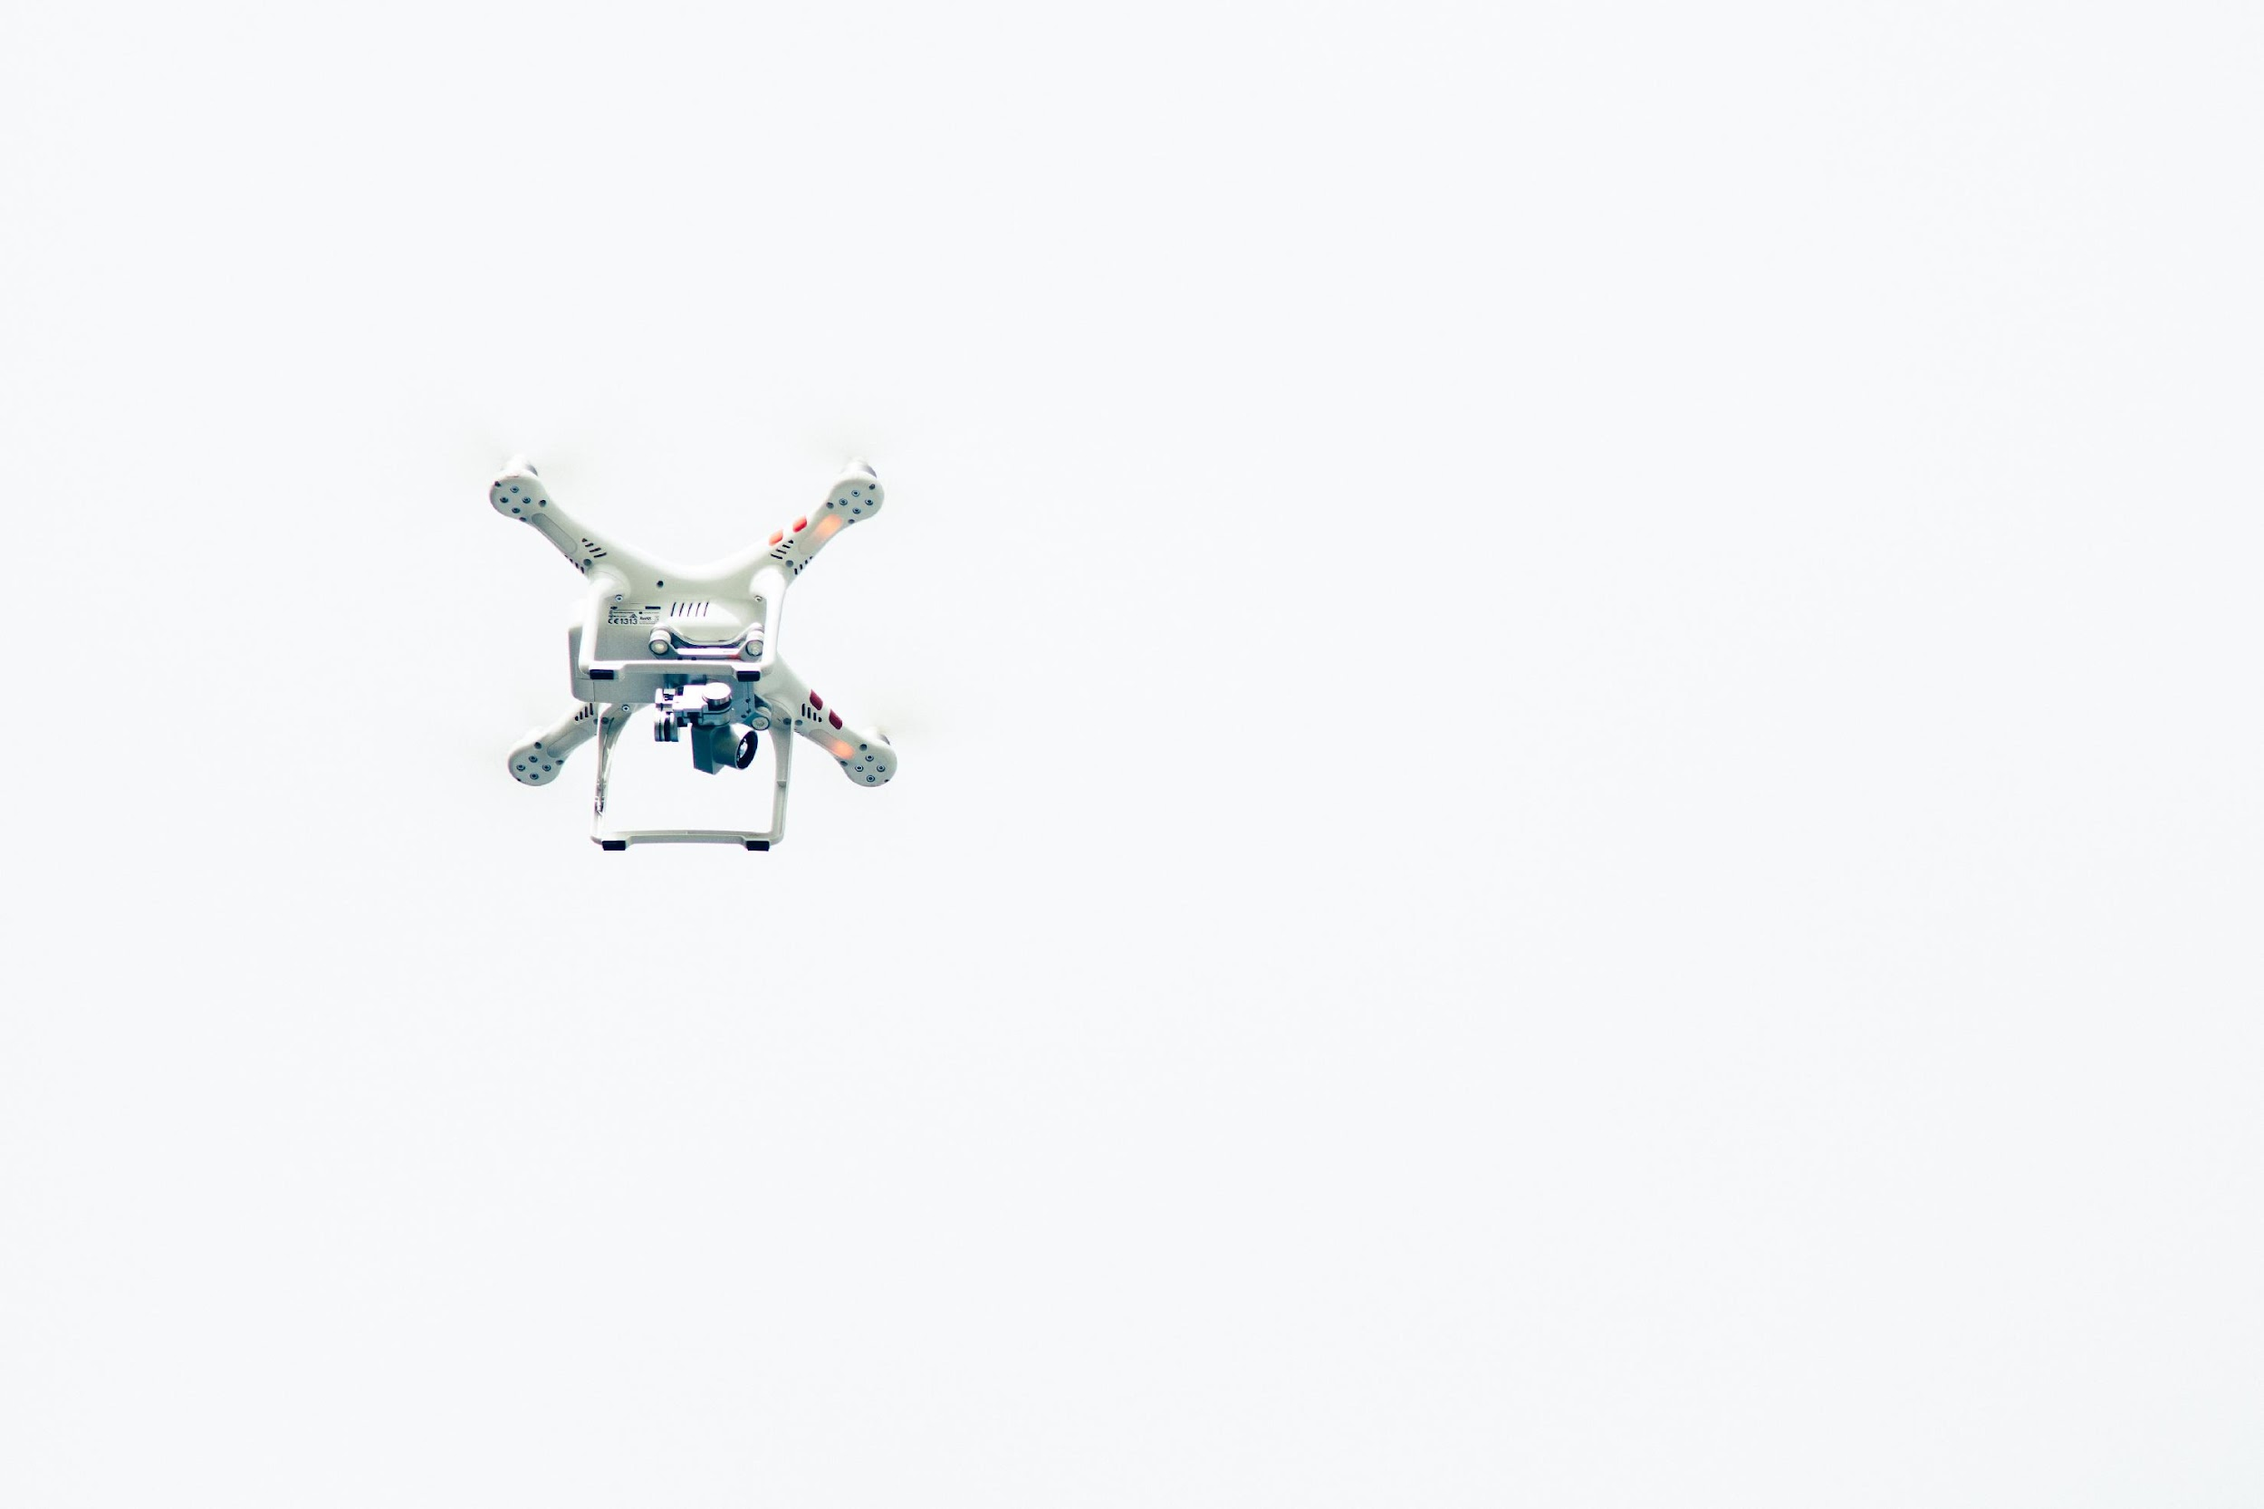
Deep Learning Method of
Drone Detection Using
Acoustic and Visual Features
2. Introduction
2.1. Aim of The Project
2.2. Process of Collecting Data
2.3. Visualization of The Experiment

Slide 6
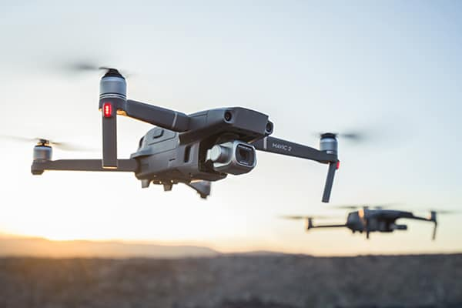
2.1. Aim of the project: (1) CAS
CAS (collision avoidance system)
Notes:
If UAVs were to collide in the air, collisions can cause bigger accidents than that of land-based vehicles. For this reason, it is requisitve to possess an effective CAS to reduce collisions between UAVs. For a CAS, various methods exist to detect and avoid target UAVs.
In this area, diverse methods on CAS are discussed. CAS is sectioned into two sections: object detection and collision avoidance approach. Furthermore, two different types of sensors are used in CAS, which are active sensors consist of sonar, LiDAR, and radar, and the passive sensors include visual camera and infrared (IR) camera.
Although passive sensors have a such limitation of being impacted by the weather condition, it is beneficial in many perspectives, which are small, light-weight, lower consumption, and easy to install on UAVs.
Collision Avoidance approaches have four methods: geometric, force-field, optimized, and sense and avoid. From those methods, the sense and avoid system is appropriate to apply under dynamic environments, since this method has a fast reaction speed. For this project, we are aiming to illustrate a sense and avoid technology based on computer vision and acoustic signals.

Slide 7
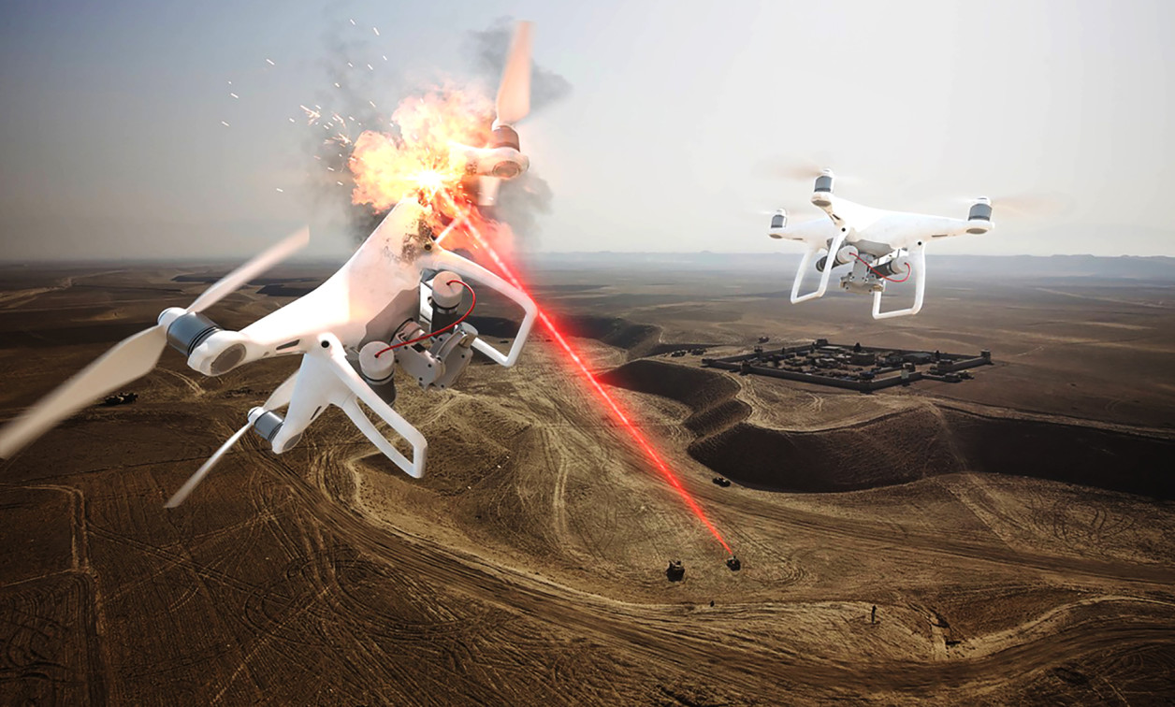
2.2. Aim of the project: (2) CUAS
CUAS (Counter Unmanned Aerial System)
Notes:
In recent years, drone flights in the Air Exclusion Zone (AEZ) have repeatedly occurred. In 2015, a man was detained, since he flew his UAV 100 feet above Lafayette Park near the White House [10]. Hence, Counter Unmanned Aerial System (CUAS) has been conducted. CUAS is a system to detect and track UAVs that approach protected or secure areas.
In fact, various researchers present a study on a shooting system using an autonomous vision-based system. If a target UAV is continuously captured in several frames, a UAV pilot changes the mode to autonomous, and the detecting UAV approaches the target UAV. A complete procedure is to move the detecting UAV towards the target UAV and put the target UAV into an inoperable status. This research demonstrates that the proposed system depends on a pilot to be practiced or skilled.

Slide 8


2.2. Process of collecting data
3. Camera
1. Video
Attached
Attached
Detecting
UAV
Target
UAV
2. Audio
4. microphone
Notes:
For our experiment, two drones were flying in the air at the same time.
The drone that is recording video and audio files is defined as the detecting drone, and another drone that is moving within the screen is defined as the target drone.
In order to record the video files, the built-in camera of the detecting drone was used.
For audio, the audio files were recorded using an iPhone 6 attached to the detecting drone.

Slide 9
2.3. Visualization of the experiment
10m
Vertical
range
Detecting
UAV
Target
UAV
Altitude
ground
0m
20m
Euclidean distance
Notes:
Now, this is a more detailed process of the experiment by visualizing it.
The goal was to both record the sound of the target drone and record the video of the target drone showing in the screen of the detecting drone.
The detecting drone was fixed at the altitude of 10m, only hovering. Then, while the detecting drone hovering, the audio and video data were collected using the camera and microphone of iPhone 6. The target drone was maintaining the Euclidean distance with detecting drones by 20m. With the fixed Euclidean distance, the target drone was moving at a range of the camera grid, changing its vertical range and altitude in the screen.

Slide 10
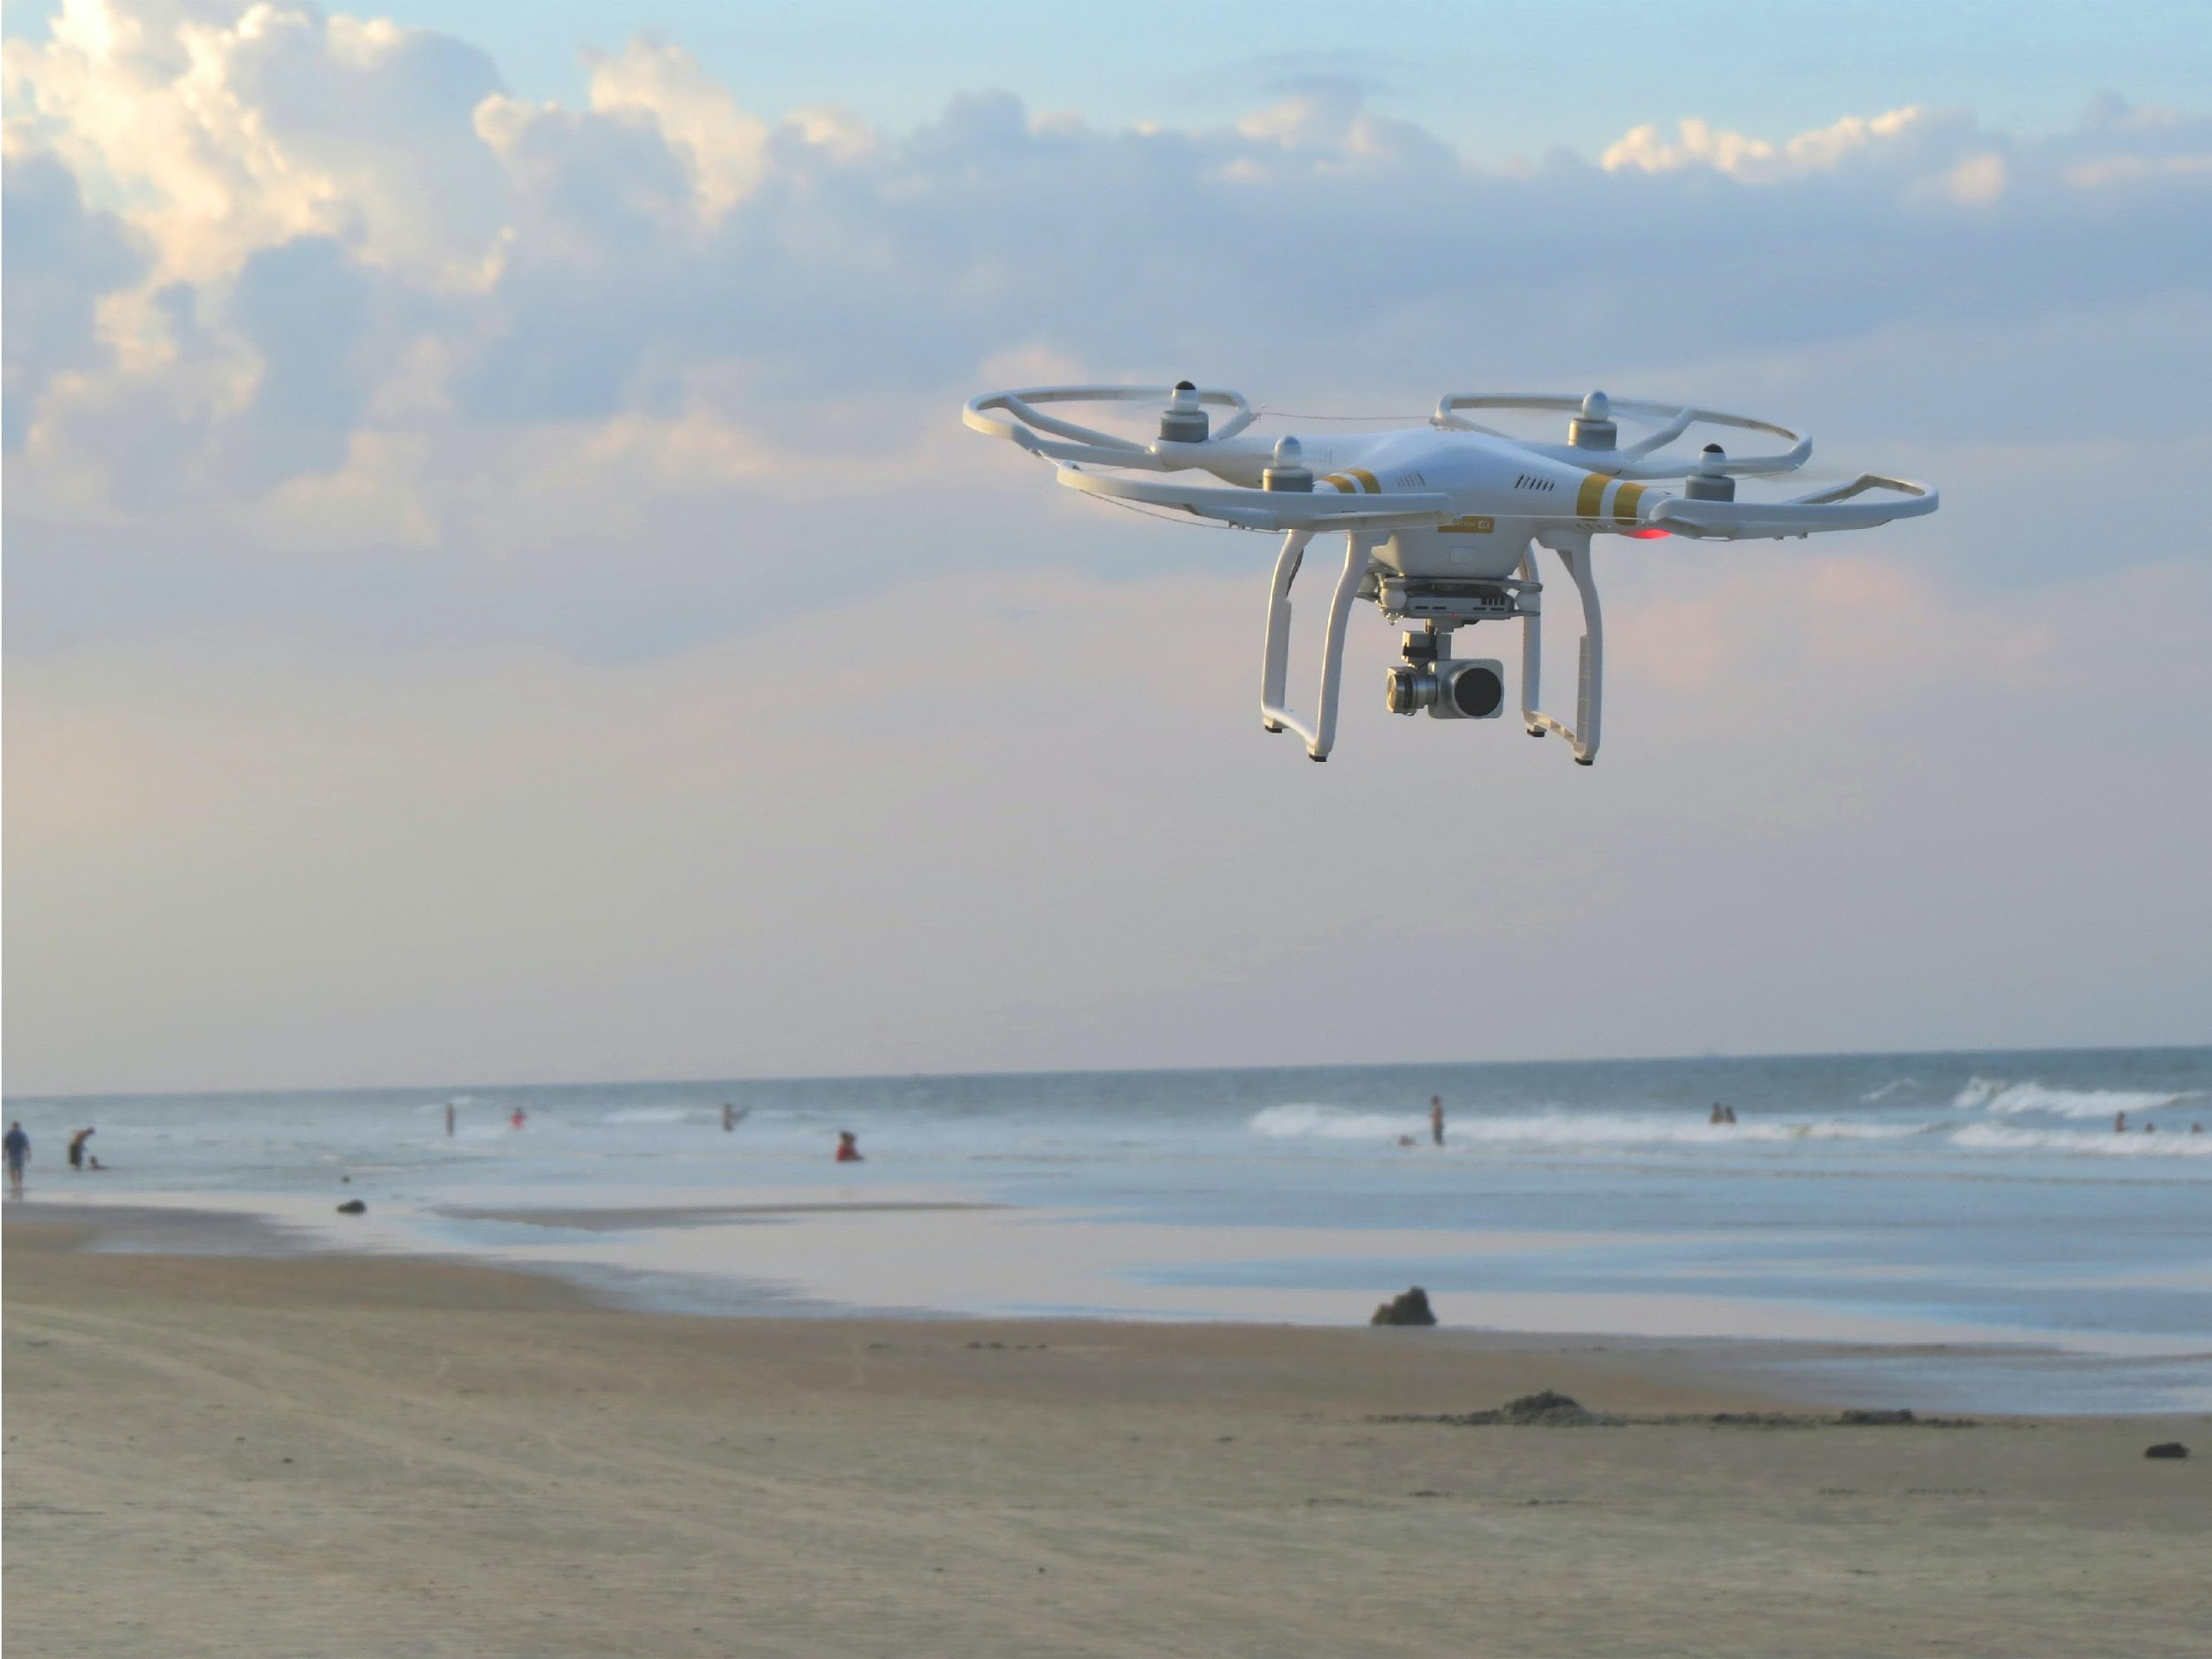
Deep learning Method of
Drone Detection using
Acoustic and Visual Features
Deep Learning Method of
Drone Detection Using
Acoustic and Visual Features
3. Outdoor Experiment Setup
3.1. Drone Type
3.2. Method of Collecting Data
3.3. Weather Condition

Slide 11
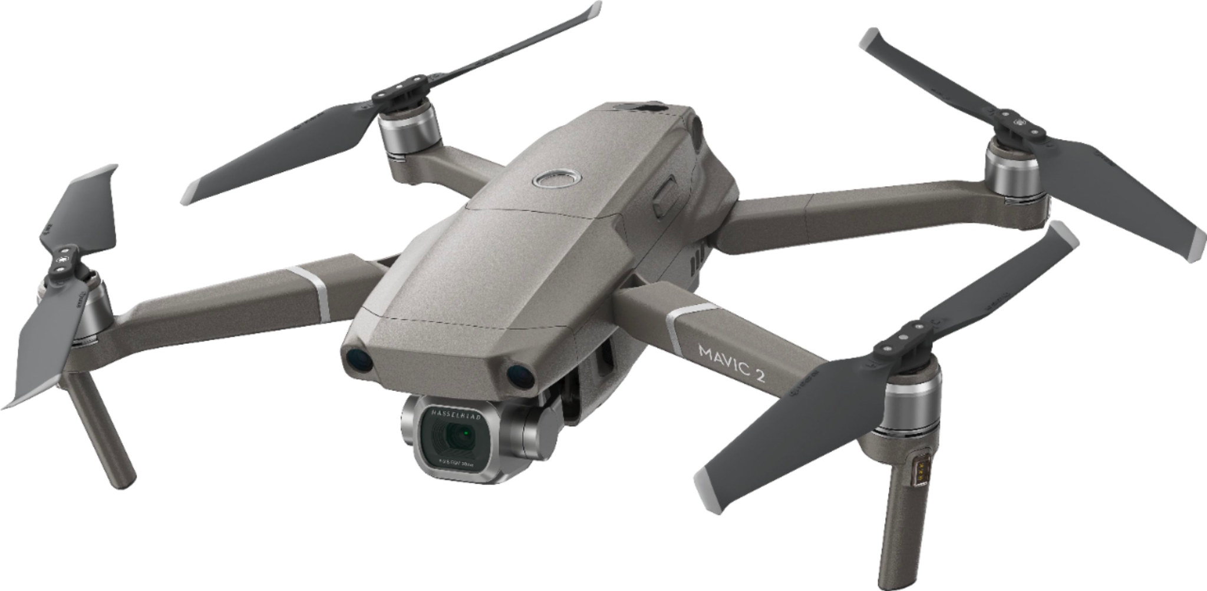
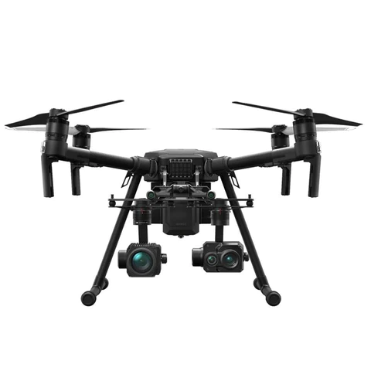
3.1. Drone Types
DJI Mavic 2 Pro
Detecting Drone
DJI Matrice
200 V2
Target Drone

Slide 12
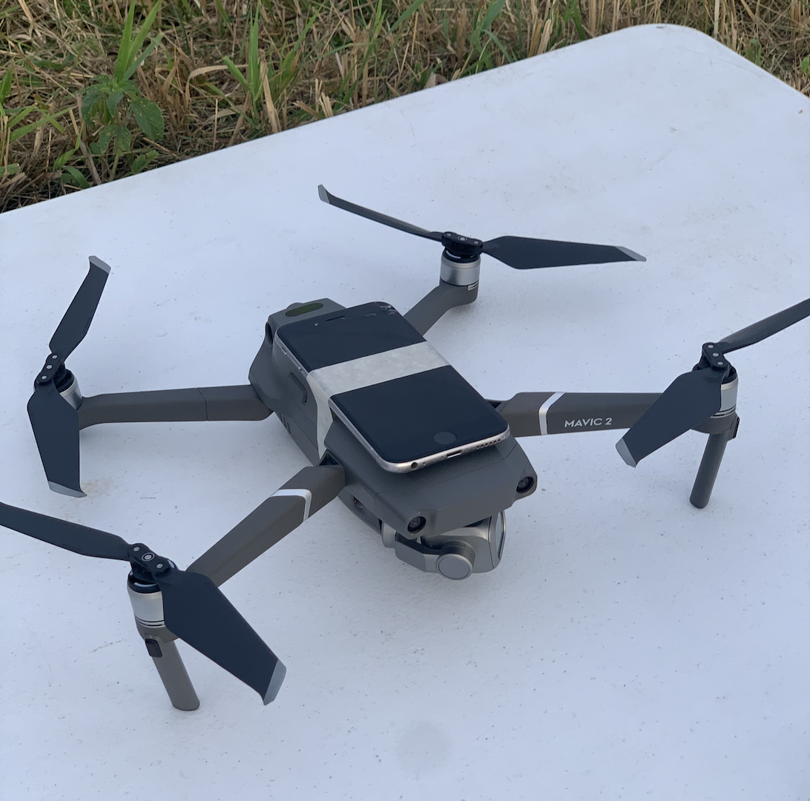
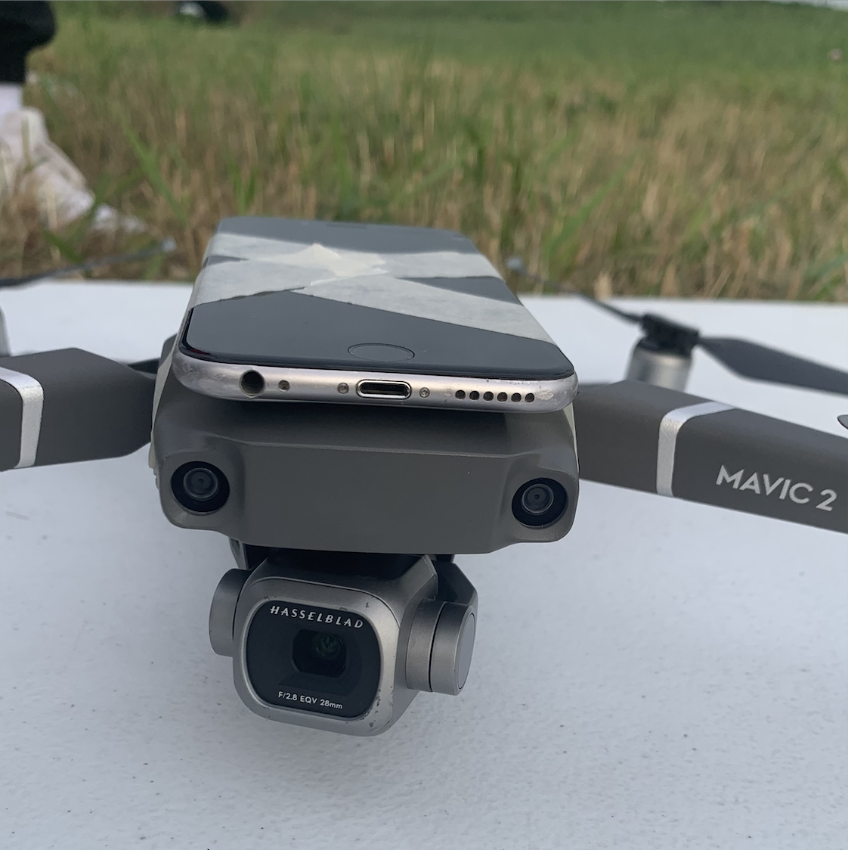
3.2. Method of collecting data - Audio & Video Files
Recording audio sound
Attached iPhone 6 using tapes
Filming video
Notes:
These are the photos of an iPhone attached to the detecting drone.
We have attached using tapes, and the microphone is heading to the same direction of the filming camera.

Slide 13
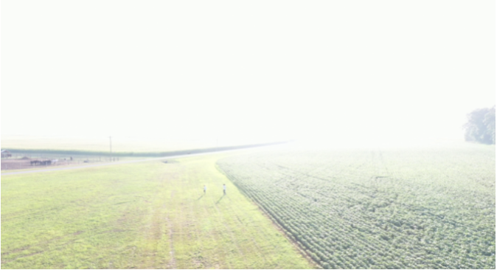
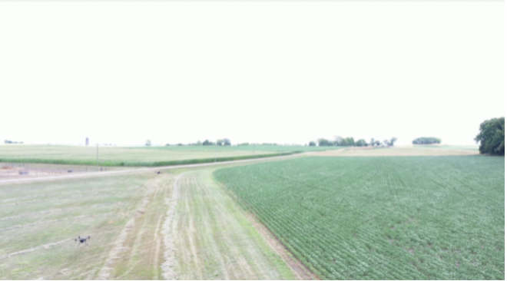
3.3. Weather Condition
Foggy Days
Sunny Days
As a dense fog came down,
a target drone could be obscured
As a view of farm opened out,
a single camera could capture a target drone clearly
Notes:
The data was collected outdoor, in a wide field. The weather conditions for the data collected varied by day. The different weather conditions include windy, sunny, and foggy days. The pictures show the difference between the video data collected in a foggy day and a sunny day.

Slide 14
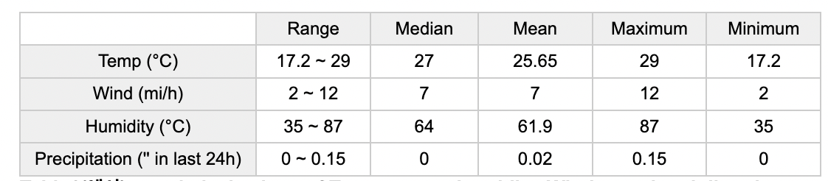
3.3. Weather Condition
Notes:
Here, this is the table that shows the overall statistical values of weather elements: temperature, wind speed, precipitation, and humidity.

Slide 15
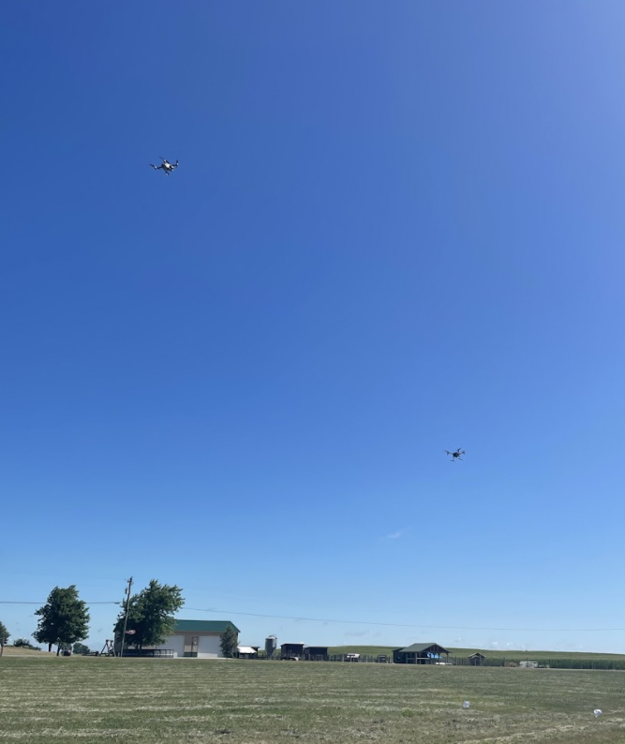
Detecting Drone
DETECT
Target Drone
Notes:
This picture shows how the experiment went. The camera and the microphone were recording the target drone’s sound and image to detect the target drone.

Slide 16
Deep Learning Method of
Drone Detection Using
Acoustic and Visual Features
4.
Experiment Process and Results
4.1. Overall Process
4.2. Image Process and Results
4.3. Audio Process and Results
4.4. Decision Fusion: Acoustic + Vision

Slide 17
Overall Process
4.1.1 Three methods of evaluation
4.1.2 System overview
4.1.3 Total number of dataset

Slide 18
4.1.1. Three Methods of Evaluation
Decision Fusion
of
Acoustic and Visual
Based
Feature
Binary Classification
Acoustic-Based
Feature
Binary Classification
Visual-Based
Feature
Binary Classification
Notes:
For the evaluation, three methods are used for this project.
1: Acoustic-based
2: Vision-based
3: the decision fusion of Acoustic and Vision-based
We predicted that the method of decision fusion of both features will show the highest performance(accuracy) among those three methods.

Slide 19
4.1.2. System Overview
T / F
Acoustic
MFCC
CNN
AND
YoLo v5x
T / F
Image
Bounding Box

Slide 20
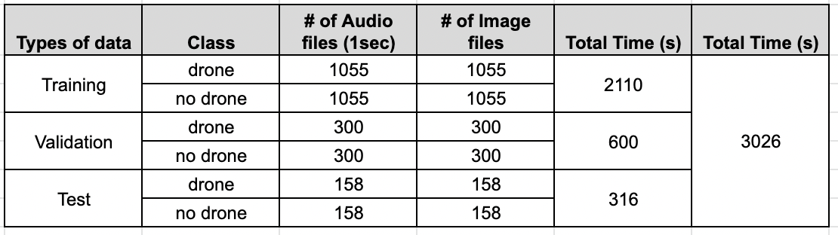
4.1.3. Total Number of Dataset
Training
Validation
Test
70% 20% 10%
Notes:
The dataset for no drone and drone were equally collected throughout the project.
The total number of data were split into a ratio of 9 : 1. 90% for training, and 10% for testing the trained model.

Slide 21
Audio Process and Results
4.2.1. Data Processing
4.2.2. MFCC Feature Map
4.2.3. Acoustic Overview
4.2.4. Cross Evaluation - CNN&SVM, MFCC & Sigmoid & 5-CV
4.2.5. Highest Performance

Slide 22
4.3.3. Acoustic Overview
1s Acoustic Signal
MFCC
CNN
Notes:
The overall process of audio shown in the slide. First, the raw audio files are segmented into 1 second of wav file. Then, from the 1 second wav file, features are extracted using MFCC(mel frequency cepstral coefficient). Finally, with the feature extracted, the features are trained with CNN model in deep learning.

Slide 23

4.2.1 Data Processing
Split into
1 second
wav file
moving_dp20m_Matrice200V2_0726_1_1.wav
moving_dp20m_Matrice200V2_0726_1_2.wav
moving_dp20m_Matrice200V2_0726_1_3.wav
.
.
.
Notes:
So, the data are split into 1 seconds.

Slide 24

4.2.1 Data Processing
Feature
(n_mfcc = 20, 40)
Mel Frequency Cepstral Coefficients
MFCC
2D | Y
X
Time
(=3026)
Mel Frequency Cepstral Coefficients
Sample of 1S
MFCC (Data Frame)
Notes:
The datasets were extracted using mel frequency cepstral coefficients as know as MFCC.
Each dataset is 2D.
The X axis is a feature that we already got using MFCC, and Y axis is a time.
The 1-second audio file extracts 3018 samples.
The number of feature is 20, as 20 is a default number in MFCC library when extracting features.
We also have tried 40 for the number of MFCC features.

Slide 25
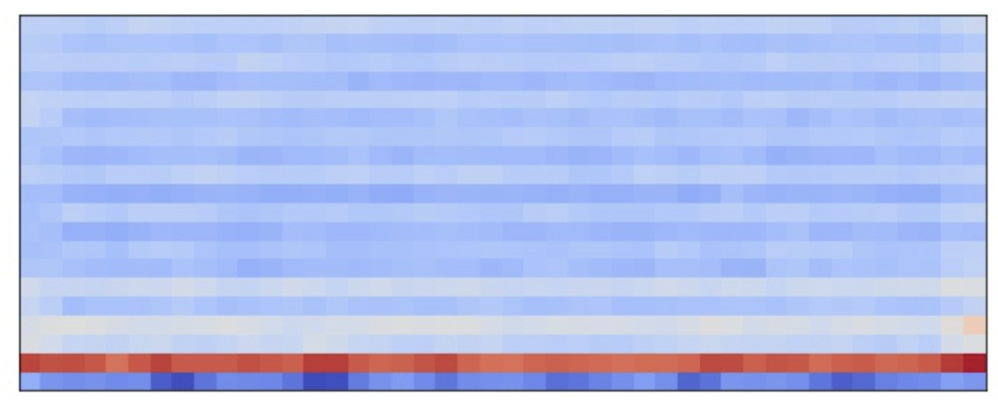
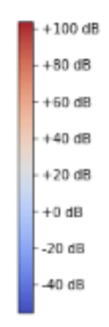
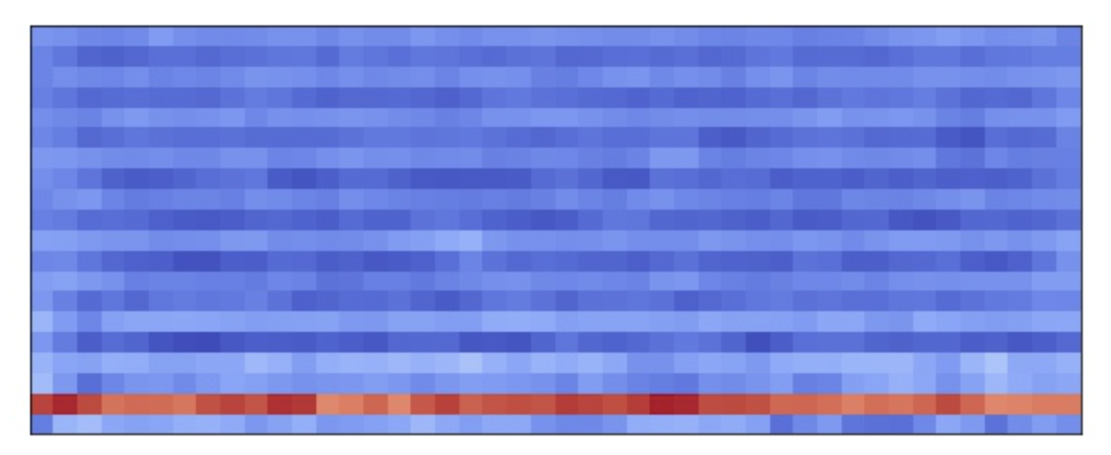
4.2.2. MFCC Feature Map
No Drone
Drone
Notes:
These are the extracted mfcc feature maps for drone data and no drone data. As you can see in the images, it is easy to see the difference between those two. It shows that the detecting drone is able to classify the sound of the target drone while flying two drones at the same time.

Slide 26
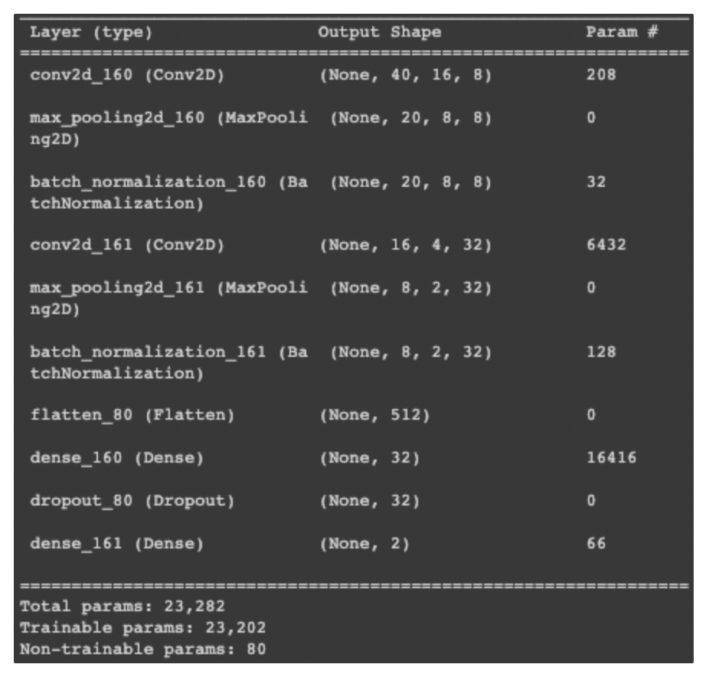
4.3.3. Model Summary
Notes:
Then, this is our CNN model summary.

Slide 27

4.3.3. 5-fold validation
Notes:
Then, this is our CNN model summary.

Slide 28
4.3.4 Cross Evaluation – Accuracy :MFCC 20 & 40, Softmax & Sigmoid, 5-CV
Monitor | Activation | n_mfcc | Batch size 16 | Batch size 32 | Batch size 64 | Batch size 128
val_loss | Sigmoid | 20 | 77.21% | 77.34% | 78.18% | 76.95%
 |  | 40 | 78.70% | 79.74% | 77.72% | 77.07%
 | Softmax | 20 | 77.60% | 77.69% | 76.95% | 76.36%
 |  | 40 | 78.83% | 76.75% | 78.31% | 78.57%
val_accuracy | Sigmoid | 20 | 77.01% | 77.99% | 75.78% | 74.35%
 |  | 40 | 80.84% | 79.74% | 79.41% | 80.06%
 | Softmax | 20 | 77.92% | 77.92% | 75.65% | 76.23%
 |  | 40 | 81.81% | 79.28% | 78.96% | 72.72%

Slide 29
4.3.5. Highest Performance
Classes | Accuracy | precision | recall | f1-score
No drone | 81.81% | 79% | 82% | 81%
drone |  | 83.1% | 79% | 80%
→ n_mfcc=40, activation=”softmax”, batch_size=16
Notes:
In the experiment, the trained CNN model using 5-fold validation was able to classify drone and no drone data with showing an accuracy of 82.14% and a consistent decrease in the loss

Slide 30
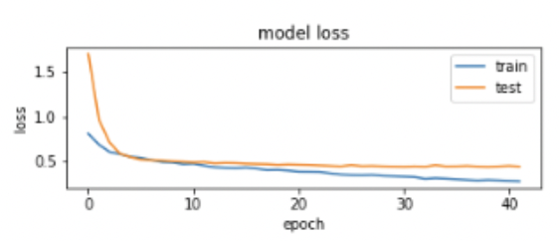
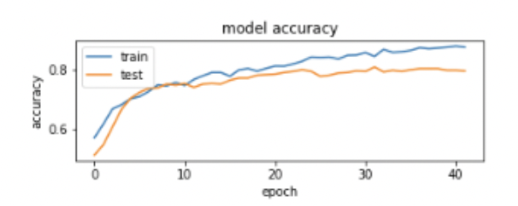
4.3.6. Highest Performance

Slide 31
Image Process and Results
4.3.1. Vision Overview
4.3.2. Collecting Data
4.3.3. YOLOv5 Model Architecture
4.3.4. Hyperparameters
4.3.5. Loss & Accuracy Curve about Train-Validation

Slide 32
4.3.1. Vision Overview
[Data Load]
Input
Video
Splitting
Frames
Different
Frames
[Object Detection Model]
Input
Image
YOLO v5
Result

Slide 33
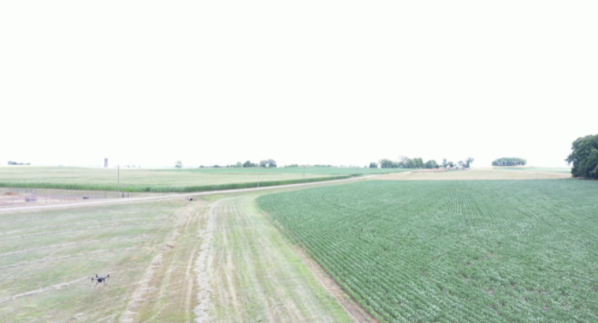
4.3.2. Data Processing
moving_dp20m_Matrice200V2_0726_1.mp4
moving_dp20m_Matrice200V2_0726_1.mp4
moving_dp20m_Matrice200V2_0726_1_1.jpg
moving_dp20m_Matrice200V2_0726_1_2.jpg
moving_dp20m_Matrice200V2_0726_1_3.jpg
.
.
.

Slide 34
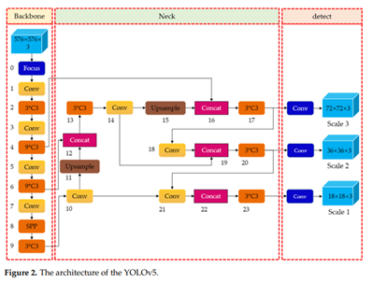
4.3.3. YOLOv5 Model Architecture

Slide 35
4.3.4. Hyperparameters
Learning rate = 0.01
Momentum = 0.937
Weight_decay =5e-4
Input Image = 640 x 640
Batch size = 16
Epoches = 30

Slide 36
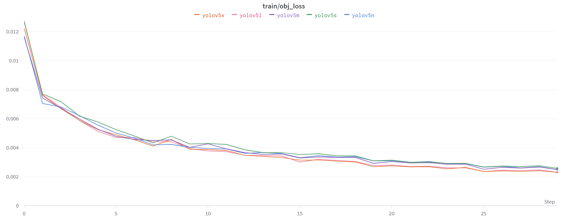
4.3.5. Loss & Accuracy Curve about Train-Validation

Slide 37
4.3.6. Performance in Training Process
Models | mAP_0.5 | Accuracy | Precision | Recall | F1-score
YoloV5n | 0.744 | 0.867 | 0.589 | 0.914 | 0.716362
YoloV5s | 0.824 | 0.876 | 0.646 | 0.914 | 0.756979
YoloV5m | 0.801 | 0.879 | 0.639 | 0.857 | 0.732116
YoloV5l | 0.76 | 0.883 | 0.619 | 0.886 | 0.728816
YoloV5x | 0.846 | 0.899 | 0.605 | 0.914 | 0.728071

Slide 38
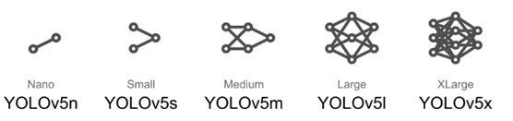
4.3.6. Performance in Training Process

Slide 39
Decision Fusion: Acoustic + Vision
4.4.1. Decision Fusion
4.4.2. Result of Decision Fusion

Slide 40
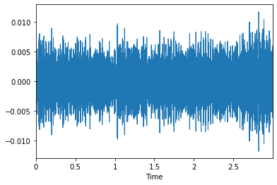
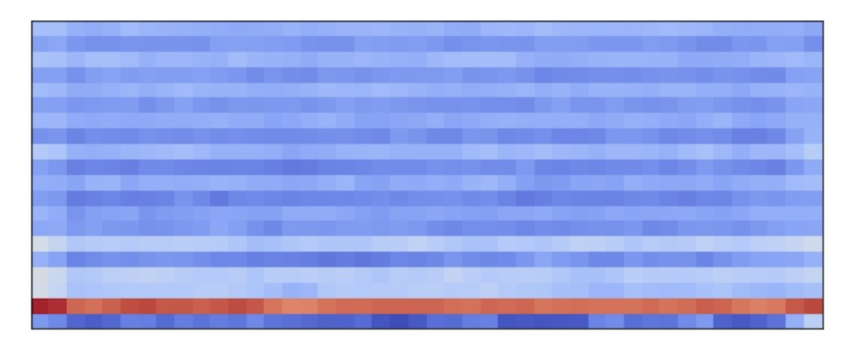
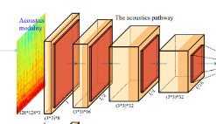
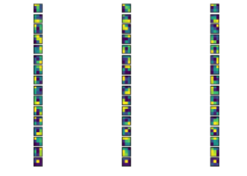
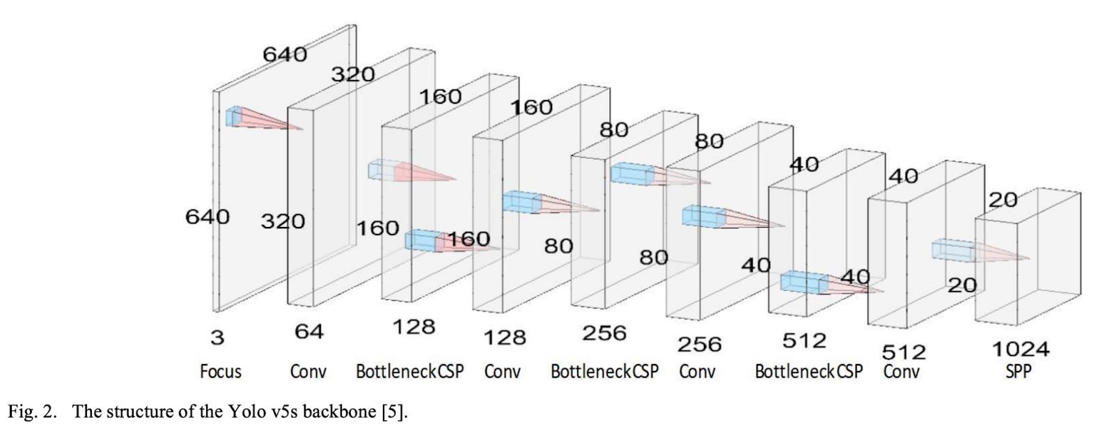
4.4.1. Decision Fusion
Audio Feature Map
Classification(CNN)
Audio Data
Decision
Fusion
Image Data
Image Feature Map
YOLOv5 (Classifier)

Slide 41
4.4.2. Result of Decision Fusion
Classes | Vision based | Acoustic based | Vision + Audio
Drone Detection Accuracy | 86.7% | 81.81% | 87.013%
→ YOLOv5n model with Audio processed with n_mfcc =40

Slide 42
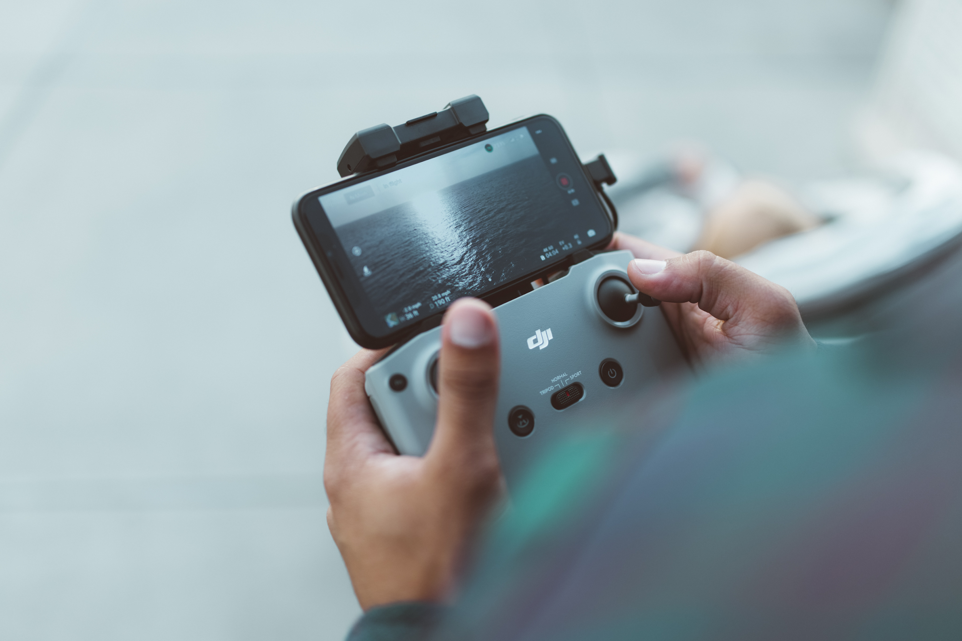
5.
Conclusion
5.1.Limitation
5.2.Future work
5.3.Reference

Slide 43
5.1. Limitation
Detecting Drone is just hovering in air space not moving
The distance between detecting drone and target drone is only 20m.
Only one target drone(DJI Matrice 200 V2) is used for experiments.

Slide 44
Future work
Experiment with Detecting Drone in hovering and moving status is more reasonable.
The distance between detecting drone and target drone will be 20m~100m.
Various type of drones will be sued as a target drone.

Slide 45
Reference
[1]Grand View Research, 2021. Commercial Drone Market Size, Share Trends Analysis Report by Product, by Application, by End-use, by Region, and Segment Forecasts, 2021-2028, April., 26, 2021.
[2] Meisenzahl, M., 2020. UPS will start delivering CVS prescriptions by drone in Florida —here’s how it works. INSIDER, https://www.businessinsider.com/ups-deliver-cvs-prescription-medications-by-drone-the-villages-2020-4.
[3]Motlagh, Naser Hossein, Miloud Bagaa, and Tarik Taleb. ”UAV-based IoT platform: A crowd surveillance use case.” IEEE Communications Magazine 55.2 (2017): 128-134.
[4]Stevenson, B., 2016. A320 collision heightens UAV safety concerns.FlightGlobal,https://www.flightglobal.com/civil-uavs/a320-collision-heightens-uav-safety-concerns/120348.article.
[5]Science and Technology. 2022. Counter-Unmanned Aircraft Systems (C-UAS), https://www.dhs.gov/science-and-technology/counter-unmanned-aircraft-systems-c-uas.
[6]GUAN, X., LYU, R., SHI, H. and CHEN, J., 2020. A survey of safety separation management and collision avoidance approaches of civil UAS operating in integration national airspace system.
Chinese Journal of Aeronautics , 33(11), pp.2851-2863.
[7]Yang, Bowon, et al. ”UAV detection system with multiple acoustic nodes using machine learning models.” 2019 Third IEEE International Conference on Robotic Computing (IRC). IEEE, 2019.
[8]McCoy, James, et al. ”Ensemble Deep Learning for Sustainable Mul-timodal UAV Classification.”IEEE Transactions on Intelligent Trans-portation Systems(2022).
[9]Abdullah, H., 2015. Man Detained for Flying Drone Near White House.NEWS,https://www.nbcnews.com/news/us-20news/20man-20detained-20trying-20fly-20drone-20near-20white-20house-20n359011
[10]A. R. Wagoner, D. K. Schrader and E. T. Matson, ”Towards a vision-based targeting system for counter unmanned aerial systems (CUAS),”
2017 IEEE International Conference on Computational Intelligence and Virtual Environments for Measurement Systems and Applications(CIVEMSA)
, 2017, pp. 237-242, doi: 10.1109/CIVEMSA.2017.7995333.
[11]Yasin, Jawad N., et al. ”Unmanned aerial vehicles (uavs): Collision avoidance systems and approaches.” IEEE access 8 (2020): 105139-105155.
[12]Sharma, Sachin Umesh, and Dharmesh J. Shah. ”A practical animal de-tection and collision avoidance system using computer vision technique.”IEEE Access 5 (2016): 347-358.
[13]Liu, Hao, et al. ”Drone detection based on an audio-assisted cameraarray.”2017 IEEE Third International Conference on Multimedia BigData (BigMM). IEEE, 2017.

Slide 46
Thank you ☺

